Slide 1
Leveraging BIRT Reporting in Your Applications
Scott Rosenbaum
BIRT Project Management Committee,
Innovent Solutions, Inc.

Slide 2

Intro - What is Eclipse?
Open Source
Community
Builds
Universal
Development
Platform
Supports
Enables
Member
Supported
Foundation
Enables
Ecosystem

Slide 3
Intro - Current Eclipse Architecture
Ecosystem
Java Dev Tools
C/C++ Dev Tools
Device Software Development Platform
Web Tools
J2EE
Web Services
Web apps
Data Tools Platform
Business Intelligence & Reporting
BIRT
Test and Performance
Frameworks
Modeling Frameworks
Graphical Frameworks
Tools Platform
Project Model
Rich Client Platform
Runtime
(OSGi)
Generic Workbench
Update

Slide 4
Intro - BIRT Project Goals
Open Source
Simple to Use
Enterprise Ready
Design for Extensibility
Be a Better Report Platform
1.0
2.0
2.1 (June 06)
3.0
Operational / Static
Reporting
Ad hoc Query
Reporting
Analytics/OLAP/
Data Mining
Business Intelligence Continuum
Notes:
Appealing to a Broader Community
BIRT will address a new problem space for Eclipse that broadens the appeal of the Eclipse platform. By addressing this new market for Eclipse, BIRT aims to bring a new class of developers - report developers - into the Eclipse community.
Simple to Use
From the outset, the BIRT project regards ease-of-use to be a key objective for the project. Reporting technology is used by a broad range of users with a wide variety of skill sets - therefore the tool needs to be approachable and intuitive. The BIRT project team are focused on ensuring that users can quickly become productive with the technology.
Enterprise Ready
BIRT 1.0 will leverage the surrounding Eclipse infrastructure for Enterprise activities such as source code management and deployment of BIRT reports in the application. In addition, the initial release of BIRT will provide for support for key enterprise data bases such as Oracle and DB2.
Design for Extensibility: Be a Better Platform
Extensibility is a core principle behind the BIRT project. Extensibility will be supported in a number of areas: data access (both design time and runtime); report output formats; chart types; report components; and business logic.

Slide 5
Presentation Map
Committers
Core BIRT Development
BIRT Extension Points
Chart Engine API
Design Engine API
Engine API
Report Viewer
Leveraging BIRT In Applications
Scott Rosenbaum
Right Now
Integrators
Script / ScriptAPI
Expressions
Drag & Drop / Properties
Users
BIRT: The Eclipse
Reporting Framework
Krishna Venkataraman
Thursday 10:30

Slide 6
BIRT Audience
Committers
Core BIRT Development
BIRT Extension Points
Chart Engine API
Design Engine API
Engine API
Report Viewer
Integrators
Script / ScriptAPI
Expressions
Drag & Drop/Properties
Users

Slide 7
BIRT Report Designer
Eclipse Report IDE to support Report Development Process
Acquire Data
  SQL, Java Objects, XML
Report Structure
  Add the visual representations of the data (tables, charts, etc.)
Report Format
  Apply Styles (CSS based)
Deploy
  BIRT Web Viewer or Engine API Integration

Slide 8
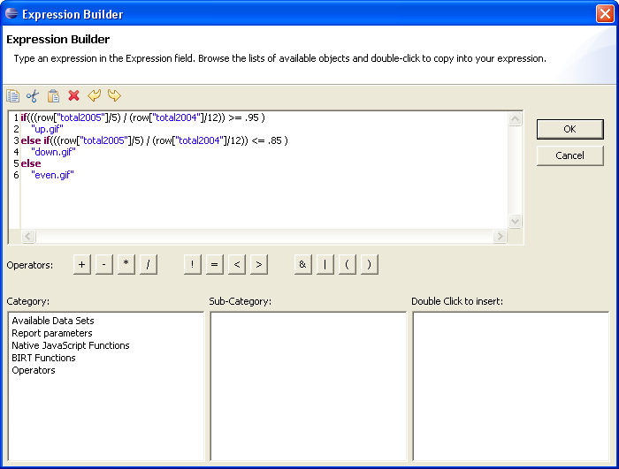
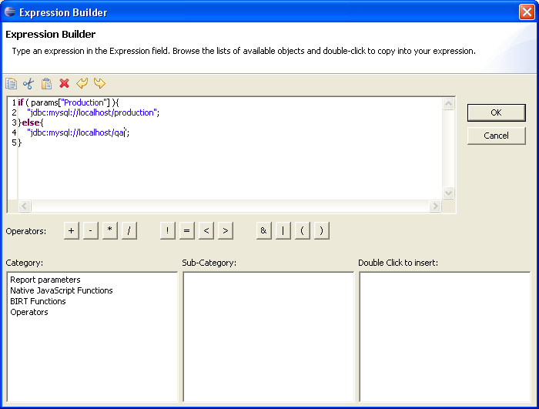
Expressions
Basic Report Customization
Dynamic report designs
Expressions are written in BIRT JavaScript
  BIRT Expression Builder
  Context sensitive

Slide 9
Expression Operations
Value expressions
Table of contents
Bookmarks
Grouping
Sorting
Images
Search Keys
Data Filters
Data Computed values
Parameter Binding
Action (hyperlink)
Map Rule
Highlight Rule
Hide Rule

Slide 10
Quick Report Demo

Slide 11
Basic Reporting UI
For more information on building reports with BIRT, please attend the:
BIRT: The Eclipse Reporting Framework
Thursday at 10:00
Krishna Venkatraman

Slide 12
BIRT Audience
Committers
Core BIRT Development
BIRT Extension Points
Chart Engine API
Design Engine API
Engine API
Report Viewer
Integrators
Script / ScriptAPI
Expressions
Drag & Drop / Properties
Users

Slide 13
BIRT Events
Extend / modify pre-defined points during report execution
Generation Phase
Presentation Phase
BIRT Events
Report Level
Initialize
beforeFactory
afterFactory
Report Element
onPrepare
onCreate
Report Level
Initialize
beforeRender
afterRender
Report Element
onRender
Data Source/Set
beforeOpen
afterOpen
onFetch
beforeClose
afterClose

Slide 14
Events - Run then Render Pipeline (Web viewer)
Report
Designer
Design
Engine
Java Event Handlers
JavaScript Event Handlers
RptDesign
XML
Generation Phase
Presentation Phase
Paginated HTML
PDF
CSV
Report Engine
JDBC
XML
FlatFile
Scripted
RptDocument
Report
Document
optional

Slide 15
Events - Run then Render Pipeline (Web viewer)
Generation Phase
Initialize
Report
onPrepare
onPrepare
Table
onPrepare
Row
beforeFactory
DataItem
beforeOpen
Data Set
afterOpen
onFetch
onCreate
onCreate
onCreate
beforeClose
afterClose
afterFactory
Presentation Phase
beforeRender
onRender
onRender
onRender
afterRender

Slide 16
Events - Run & Render Pipeline (Default Preview)
Report
Designer
Design
Engine
Java Event Handlers
JavaScript Event Handlers
RptDesign
XML
Generation and Render Phase
Paginated HTML
PDF
CSV
Report Engine
JDBC
XML
FlatFile
Scripted
Report
Document
in memory
optional

Slide 17
Events - Run & Render Pipeline (Default Preview)
Initialize
onPrepare
onPrepare
Report
onPrepare
Table
beforeFactory
Row
beforeRender
DataItem
beforeOpen
Data Set
afterOpen
onFetch
onCreate
onRender
onCreate
onRender
onCreate
onRender
beforeClose
afterClose
afterRender
afterFactory

Slide 18
BIRT Event Handlers
JavaScript Event Handlers
Easy To Use
  Exposed in BIRT IDE
  Code Completion
  Access to other report elements
  Access to BIRT functions
    Total, Financial, DateTime
Access to Java Objects
  Instantiated or Passed
No Debugging (its coming)
Java Event Handlers
Written as POJO’s
More Powerful
  Eclipse Java Development IDE
  Eclipse Debugging

Slide 19
Scripting Demo

Slide 20
BIRT Audience
Committers
Core BIRT Development
BIRT Extension Points
Chart Engine API
Design Engine API
Engine API
Report Viewer
Integrators
Script / ScriptAPI
Expressions
Drag & Drop / Properties
Users

Slide 21
Deploying BIRT Reports
Paginated HTML, PDF, TOC, Bookmarks, CSV
Two Viewers
Eclipse BIRT Viewer
  Eclipse Plug-in
  Built in Tomcat web app
BIRT Web App Viewer
  J2EE Web Application
  Run and view reports
  birt-runtime distribution
Eclipse BIRT Viewer
BIRT Web App
Web Viewer
Web Viewer
ReportEngine
ReportEngine
RptDesign
XML
Design File
RptDocument
Report
Document

Slide 22
BIRT Web Application
Quickest way to deploy BIRT reports on the Web
Generate reports as PDF or HTML
Supports Paginated HTML
Retrieves Images and Chart Output
Supports TOC and Bookmark Functionality
Parameter Entry
Export to CSV

Slide 23
Anatomy of the Web Viewer
BIRT Report Viewer Client
BIRT Report Viewer Server
AJAX
Viewer
Fragments
Report Engine Service
ExecuteReport
GetRptParameterDefs
GetPage
GetPageCount
GetToc
ExtractReportItemData
Toolbar
Page Navigation
TOC
Parameters
Export Data
URLs
SOAP
Document Handler
_{ParameterAccessor.java}
_{ViewerAttributeBean.java}
_{DocumentProcessor.java}
_{ReportEngineService.java}
Notes:
ParameterAccessor.java – Used to retrieve URL Parameters
ViewerAttributeBean.java – Used to pass data between calls and to communicate with the ReportEngine Service
DocumentProcessor.java – Fired up by the SOAP Endpoint and handles the BIRT Viewer AJAX operations.
ReportEngineService – Encapsulates the ReportEngine API to execute and render reports.

Slide 24
Web Viewer Demo

Slide 25
BIRT Audience
Committers
Core BIRT Development
BIRT Extension Points
Chart Engine API
Design Engine API
Engine API
Report Viewer
Integrators
Script / ScriptAPI
Expressions
Drag & Drop / Properties
Users

Slide 26
BIRT Integration
Report Object Model
BIRT Report Designer
Eclipse Plugins
BIRT Report Viewer
Eclipse Plugin /
Web Application
BIRT Model API
Design Engine API
Report Design
XML
Report Engine
API
Report
PDF
HTML
Data Tools Project
(DTP)
Open Data Access
ODA API
Chart Engine
API
BIRT Chart
User Interface API

Slide 27
Report Engine Usage
Paginated HTML, PDF, TOC, Bookmarks, CSV
Eclipse Viewer
BIRT Web App
J2EE App
Java Application
Web Viewer
Web Viewer
Custom Servlet
ReportEngine
ReportEngine
ReportEngine
ReportEngine
RptDesign
XML
Design File
RptDocument
Report
Document

Slide 28
Report Engine API
Run-time interface
Report Parameter Interface
Generation Options
  Run And Render (memory based)
  Run Then Render (creates rptdocument)
Render Options
  HTML
  Paged HTML
  PDF
Extract data to CSV
Fetch an image or chart for a report

Slide 29
Engine API
EngineConfig
Configuration variables
- Engine Home
- Log configuration
Open Report Design. Create Engine Task.
ReportEngine
Generate one or more tasks
DataPreviewTask
Execute Report Data Sets
GetParameterDefinitionTask
Parameter Interface (get / set)
RunAndRenderTask
Generate HTML or PDF Doc
DataExtractionTask
TOC, CSV, Bookmarks, etc.
RunTask
RenderTask
Paginated HTML or PDF
RptDesign
XML
Design File
Report
Document
RptDesign
XML
Design File
Report
Document
RptDesign
XML
Design File
RptDocument
Report
Document

Slide 30
Engine API Demo

Slide 31
BIRT Audience
Committers
Core BIRT Development
BIRT Extension Points
Chart Engine API
Design Engine API
Engine API
Report Viewer
Integrators
Script / ScriptAPI
Expressions
Drag & Drop / Properties
Users

Slide 32
Design Engine API - Description
Report Designs are XML files
Design Engine allows
  Creation of Designs
  Modification of Designs
  On-Demand Report Designs
  Custom Report Designer
Create and delete report elements
Put report elements into slots.
Get and set parameter values.
Retrieve metadata
  Report elements
  Properties
  Slots
Undo/Redo
Semantic Checks on designs

Slide 33
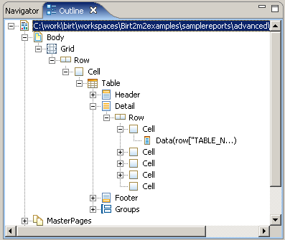
Design Engine API
Elements
  Tables, Labels, Styles etc.
Properties
  User interface to elements
  support inheritance
Slots
  element-container relationships
File Interaction
  Design validation
  Undo / redo
  Local History

Slide 34
Design Engine API – Process Overview
SessionHandle
  Opens report designs
ReportDesignHandle
  Handle to specific report design
ElementFactory
  Creates new report elements
DesignElementHandle
  GridHandle, RowHandle, CellHandle, etc
SlotHandle
  Handle to a Slot

Slide 35
Design Engine Pseudo
  // ADD A NEW PAGE MASTER
  SessionHandle session = DesignEngine.newSession( null );
  // Create a new report design.
  ReportDesignHandle design = session.createDesign( );
  // setup element factory
  ElementFactory factory = design.getElementFactory( );
  // Create a simple master page
  DesignElementHandle element = factory.newSimpleMasterPage(“NewPageMaster");
  //Get SlotHandle and add element
  design.getMasterPages().add( element );
  //Save and close report design
  design.saveAs( "c:/work/temp/JavaPolis.rptdesign" );
  design.close( );

Slide 36
Engine API Demo

Slide 37
BIRT Audience
Committers
Core BIRT Development
BIRT Extension Points
Chart Engine API
Design Engine API
Engine API
Report Viewer
Integrators
Script / ScriptAPI
Expressions
Drag & Drop / Properties
Users

Slide 38
BIRT Chart Engine API
Stand Alone Chart Generator
  Report Engine API is NOT required
  Data provided to chart through static data structure
    org.eclipse.birt.chart.datafeed - Custom User Data Set Interface
    org.eclipse.birt.chart.model.data - Interfaces defines data structure
Chart User Interface
  Optional Design time tool
JavaScript events
  Similar to the Report design script interface
ImageMap Support
  Static images in charts (PNG, GIF, JPG, BMP)
Output formats
  SWT graphics (GC), SWING graphics (Graphics2D), SVG

Slide 39
BIRT Audience
Committers
Core BIRT Development
BIRT Extension Points
Chart Engine API
Design Engine API
Engine API
Report Viewer
Integrators
Script / ScriptAPI
Expressions
Drag & Drop / Properties
Users

Slide 40
BIRT Extensions Points
Eclipse is built on the Extension Framework
BIRT Components are Eclipse Extensions
BIRT is extendable through the BIRT Extension Points (Plug-Ins)
Examples
  Emitter XLS emitter, RTF emitter, DocBook emitter
  ODA – DTP JDO, Hibernate, EJB, JNDI
  Report Item Rotated Text, Art Text
  Chart Types Custom gauges
Benefits
  Complete control customization of the BIRT environment
  Encapsulation into standard BIRT Elements and Objects

Slide 41
Downloading BIRT
Report Development Only
  BIRT-RCP
Report Development for Java Developers
  BIRT All In One – if you don’t have Eclipse
  BIRT Reporting Framework – if you have Eclipse
Deploy and Run Reports
  BIRT Runtime Engine and deployment examples
Charts
  BIRT Chart Engine and examples
Miscellaneous
  Samples, Downloads, Test Suite, Sample DB (MySql)

Slide 42
Where to Learn More
Actuate Booth – Presenter Hall
Birds of a Feather – Wednesday at 8:00
http://www.eclipse.org/birt
http://Birtworld.blogspot.com
Very active Newsgroup
Addison Wesley Books
  BIRT: A Field Guide To Reporting
  Integrating and Extending BIRT

Slide 43
Q&A

